Slide 1
Flow Estimation, Detection and Comparison
Chaoda Zheng
2020.10.13

Slide 2
Paper list
Just Go with the Flow: Self-Supervised Scene Flow Estimation (CVPR2020)
SPOT: Selective Point Cloud Voting for Better Proposal in Point Cloud Object Detection(ECCV2020)
DPDist : Comparing Point Clouds Using Deep Point Cloud Distance(ECCV2020)

Slide 3


Slide 4
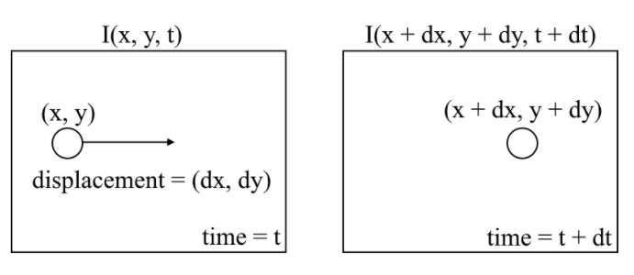
2D Flow: Optical Flow

Slide 5
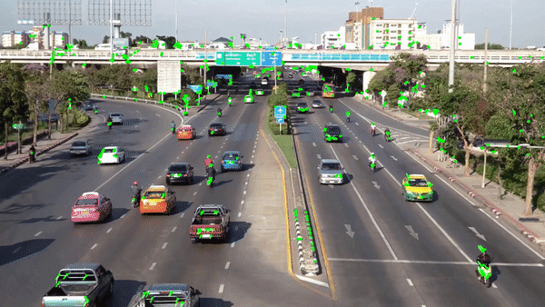
2D Flow: Optical Flow

Slide 6
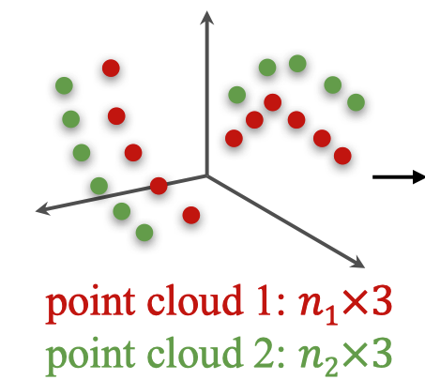
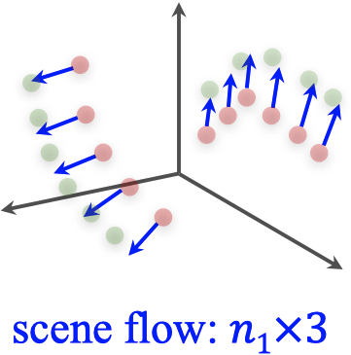
3D Flow: Scene Flow
Unlike optical ﬂow estimation, the exact 3D position of PC1 may not necessarily coincide with a point in the PC2

Slide 7
Why Self-Supervised?
Domain gaps exists between synthetic and real world data
Real world annotations are costly to obtain
they require labeling the motion for every point in a scene.

Slide 8
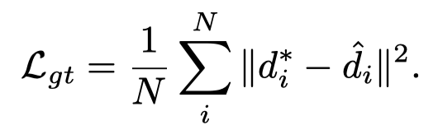
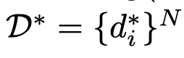
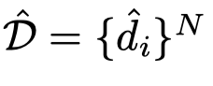
Supervised Loss
Estimated flow:
GT flow:

Slide 9
Supervised Loss
Estimated flow:
GT flow:

Slide 10
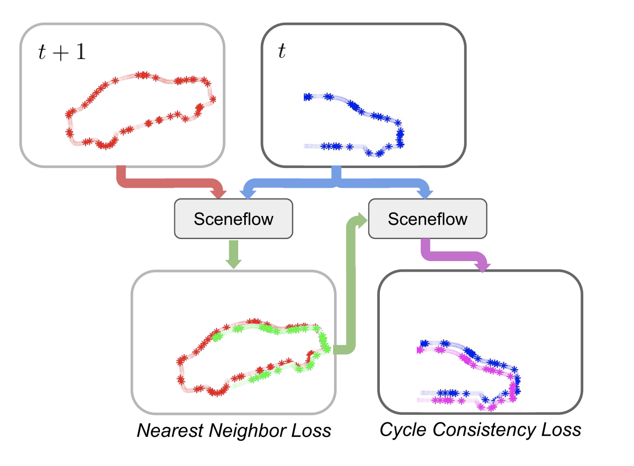
Solution : Using two self-supervised losses

Slide 11
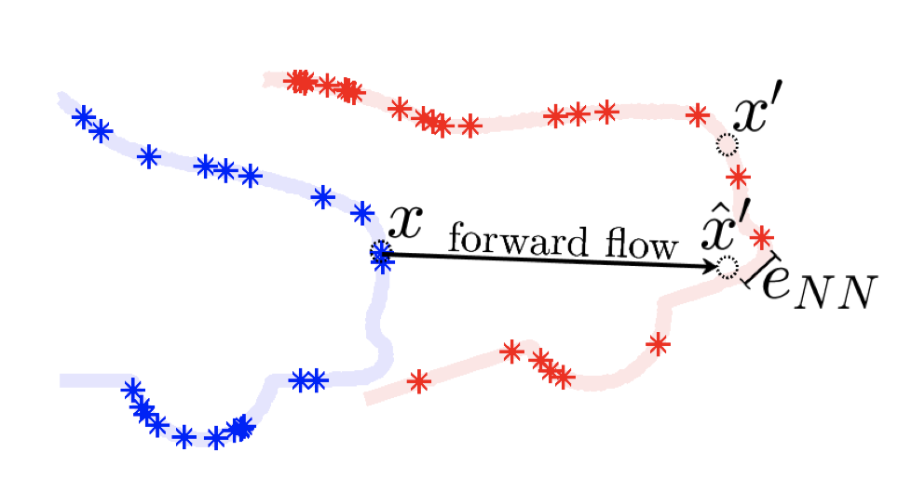
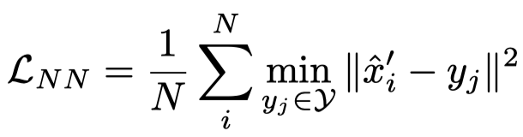
Nearest Neighbor (NN) Loss

Slide 12
Nearest Neighbor (NN) Loss
Bring the transformed point cloud and the target point cloud closer.
Useful when initial ﬂow estimate is sufﬁciently close to the correct ﬂow estimate

Slide 13
Problems of NN loss when imposed alone
Too far
the position of PC1 may not correspond with any point in PC2
Degenerate case : All points in PC1 map to a same point in PC2 -> loss = 0

Slide 14
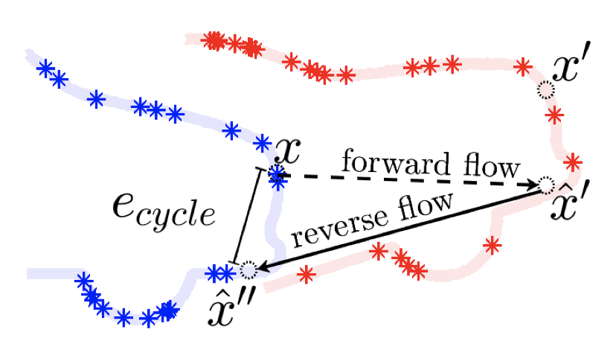
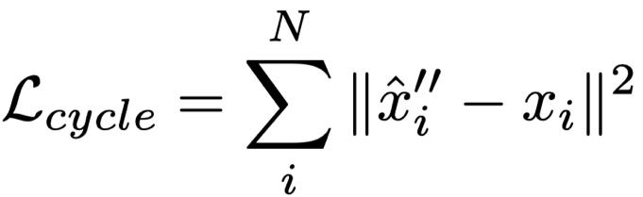
Cycle Consistency Loss
A temporal cycle ends where it started

Slide 15
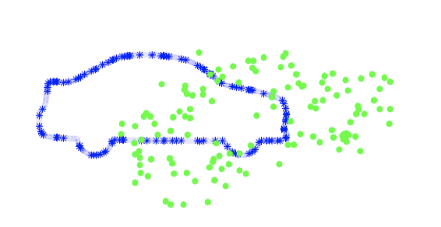
Problems of Cycle Consistency Loss
Degenerate case : 0 flow produces 0 loss
Produce unstable results due to structural distortions

Slide 16
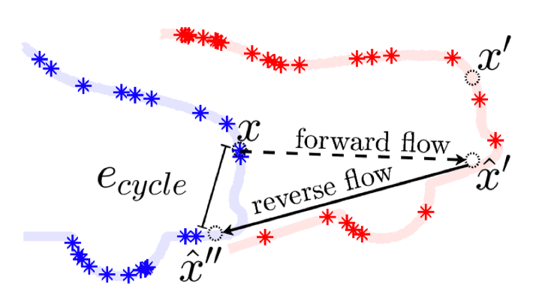
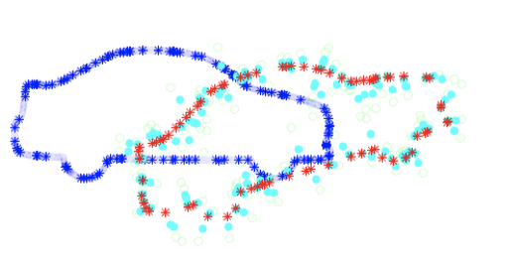
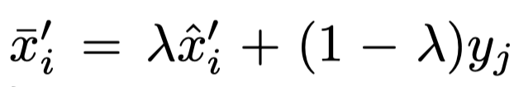
Anchored Cycle Consistency Loss
Using the nearest neighbor points (red) as anchors, we are able to stabilize the transformed cloud(cyan)

Slide 17
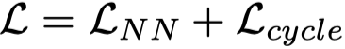
Sum the two losses
The local minima of each of the nearest neighbor and cycle consistency losses conﬂict

Slide 18
Temporal Flip Augmentation
Flip the sequences to obtain more data
Forward sequences -> reversed sequences

Slide 19
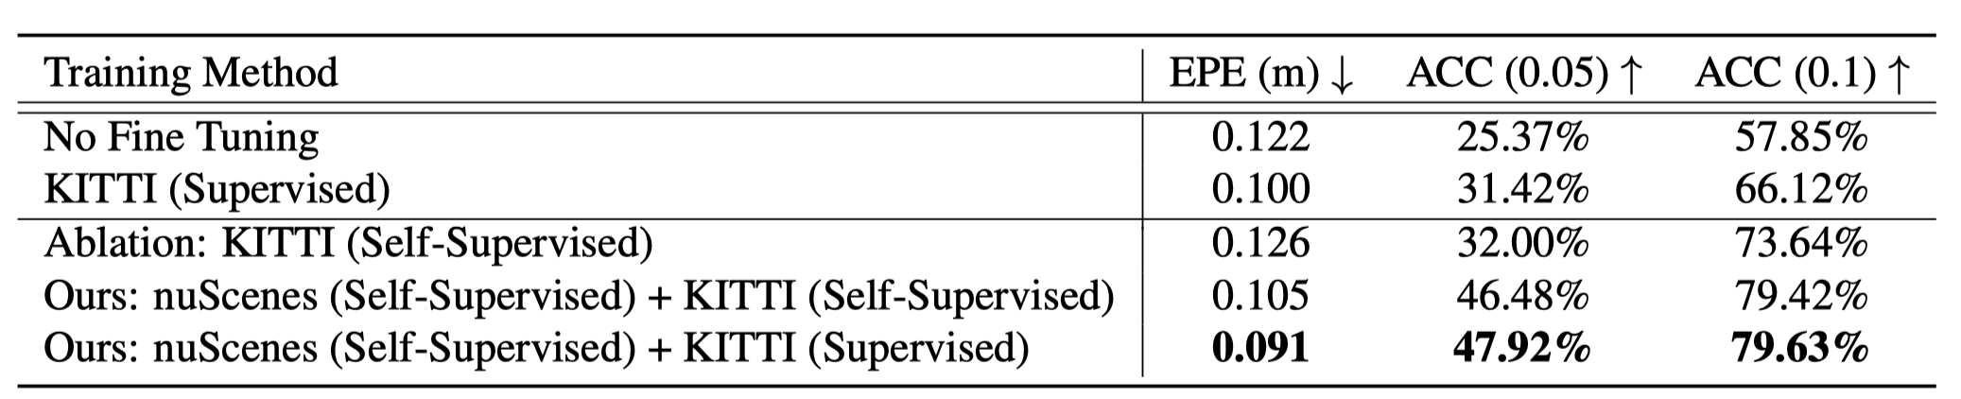
Experiments

Slide 20
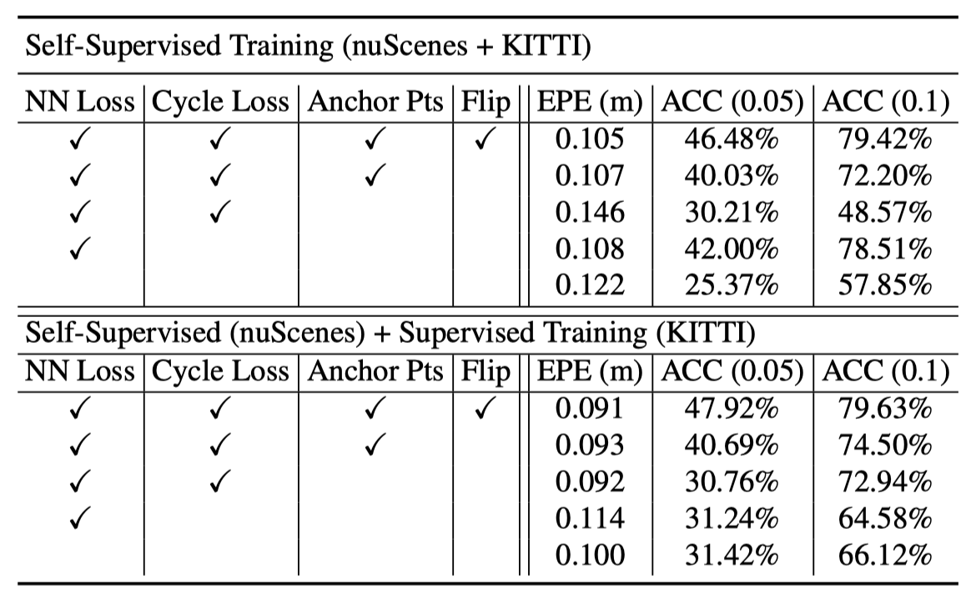
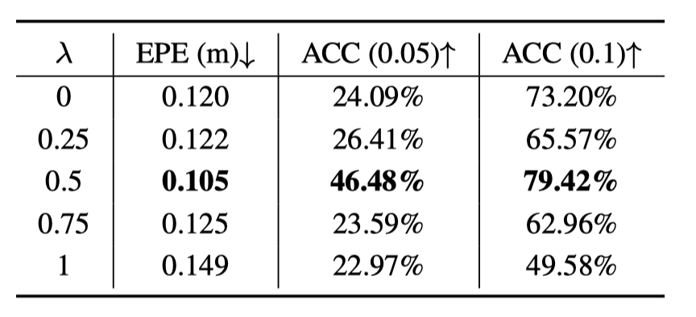
Experiments

Slide 21
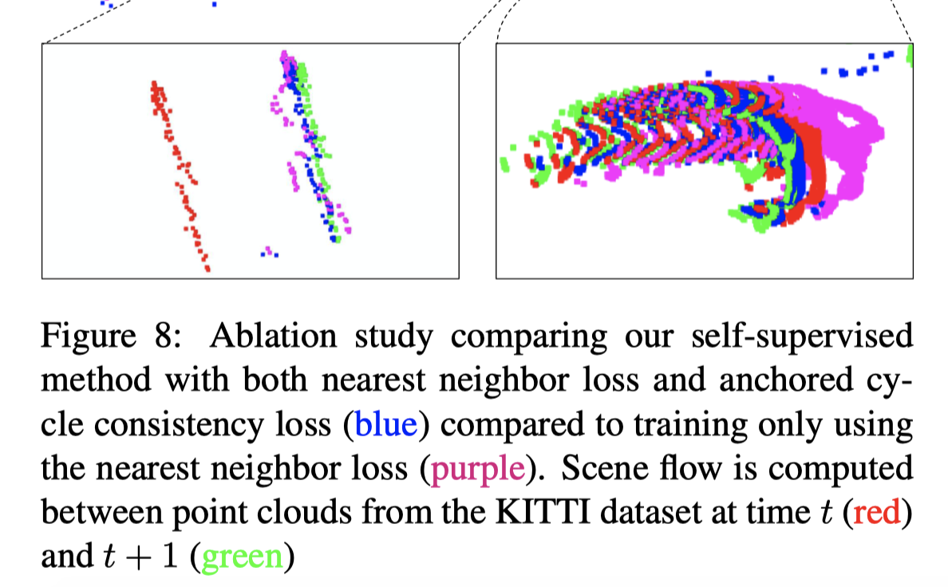
Visualization

Slide 22
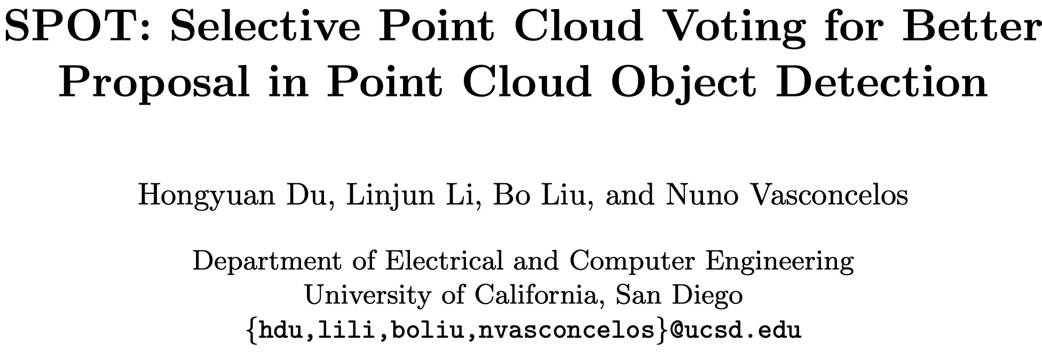

Slide 23
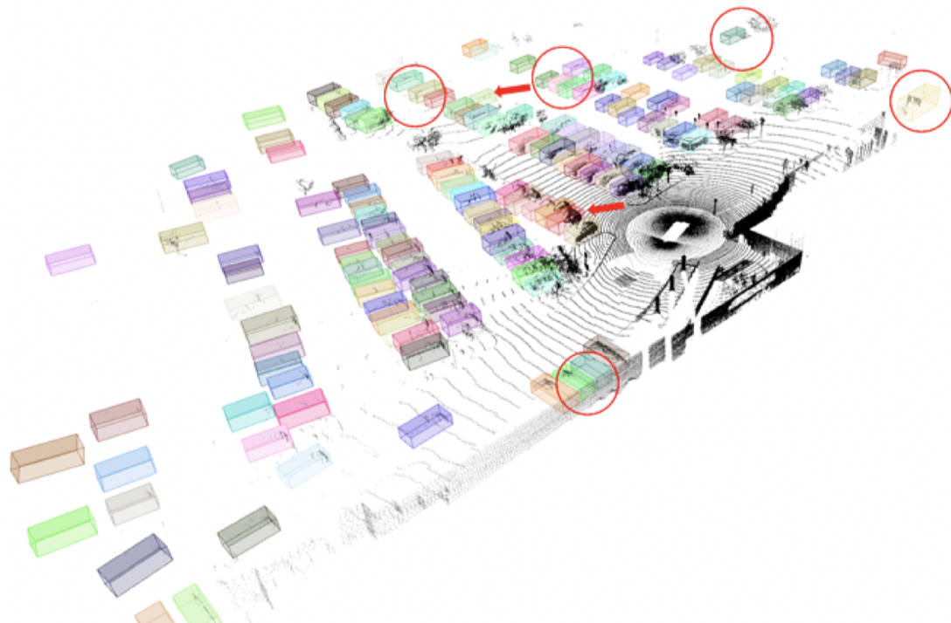
Object Detection in Lidar

Slide 24
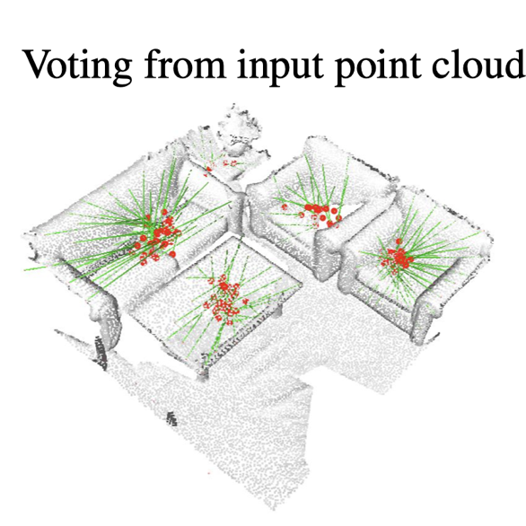
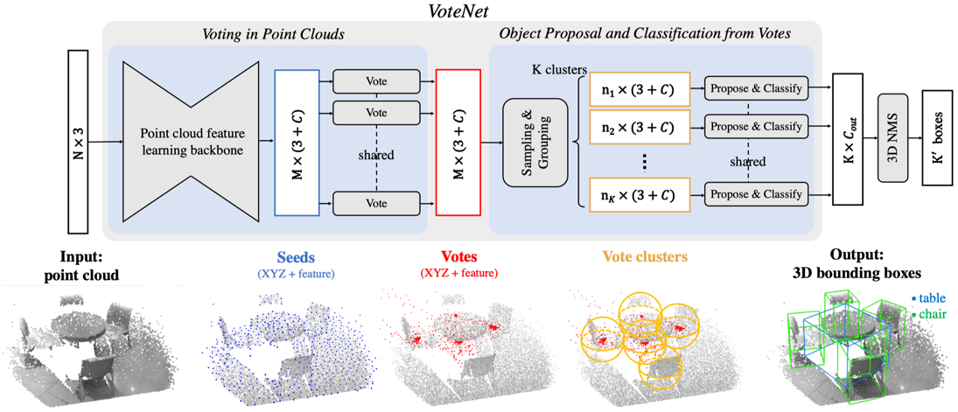
Object Detection based on Center Detection

Slide 25
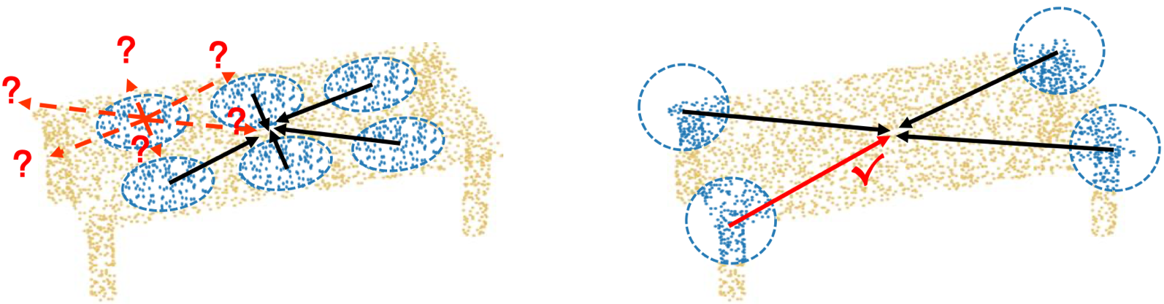
The Key Observation
1D structure points
3D structure points
Not all points on an object are equally informative of object identity and location.

Slide 26
Suspicious Coincidences
More informative for object detection but rare
Likely to either be missed or immersed in an ocean of less informative points

Slide 27
Solution?
Foreground segmentation 😐
Selective Point clOud voTing (SPOT) module 😬
increase the attention of the point cloud around points of suspicious coincidences and reduce it everywhere else

Slide 28
SPOT
Detection of locations of suspicious coincidences
voting synthesis in the neighborhood of these locations

Slide 29
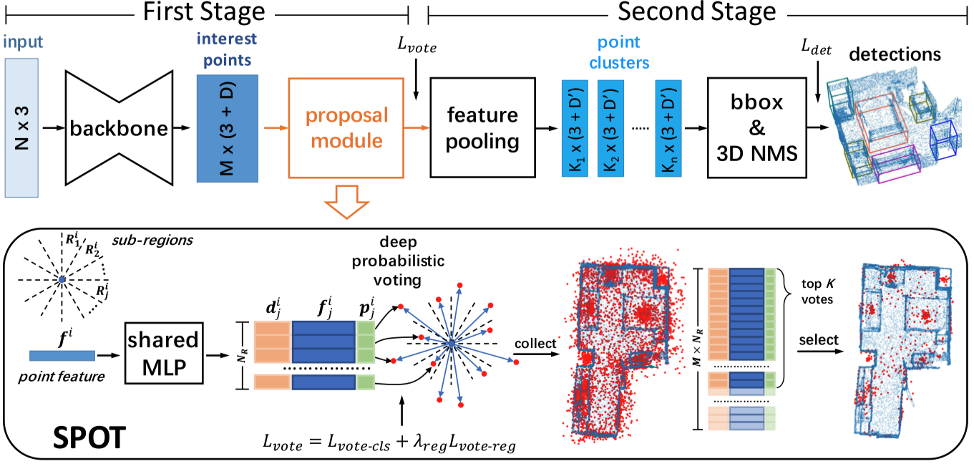
Overview

Slide 30
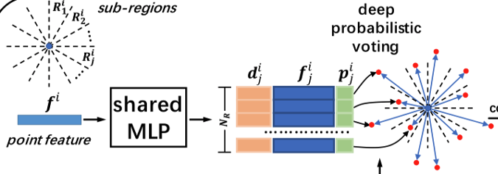
Suspicious coincidences detection

Slide 31
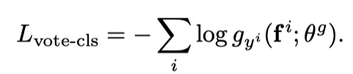
Suspicious coincidences detection
A classification problem:

Slide 32
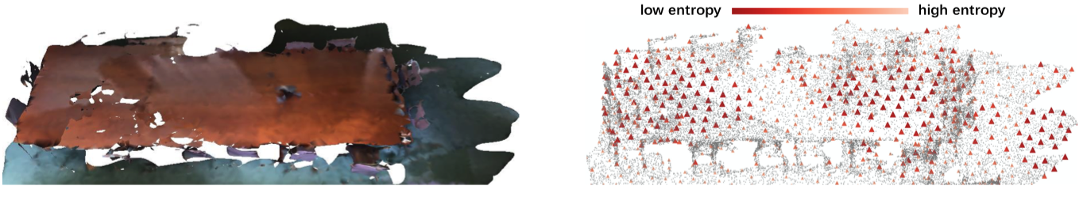
Suspicious coincidences detection
Suspicious coincidences : low uncertainty
Other points: high uncertainty

Slide 33
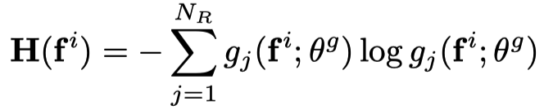
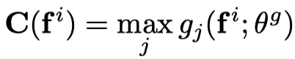
Suspicious coincidences detection
Thresholding of:
Entropy:
or
Largest probability:

Slide 34
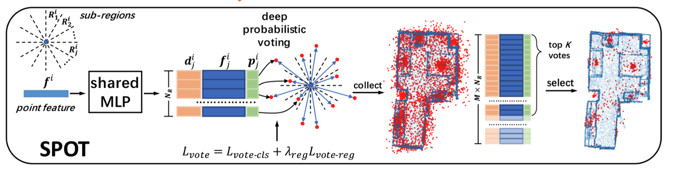
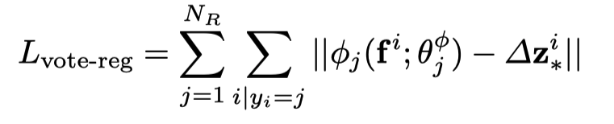
Selective Voting – the top K votes

Slide 35
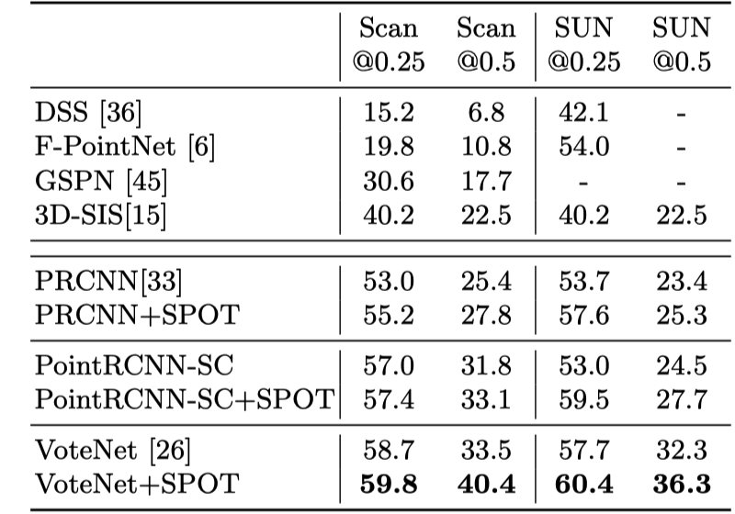
Experiments

Slide 36
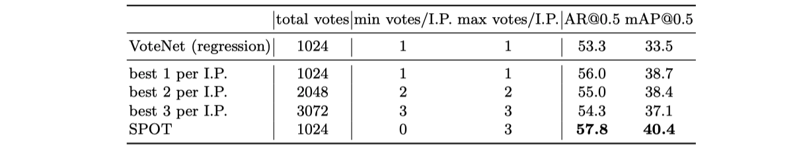
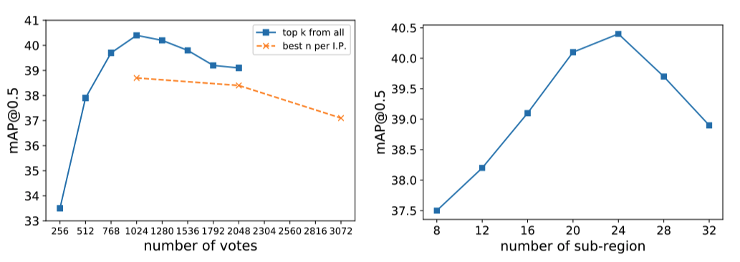
Experiments

Slide 37
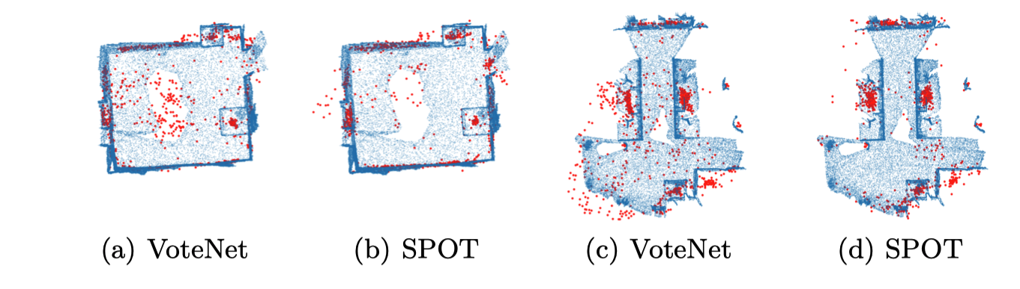
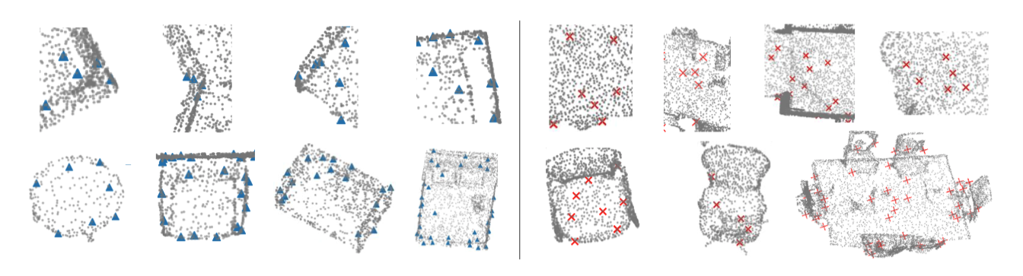
Visualization

Slide 38
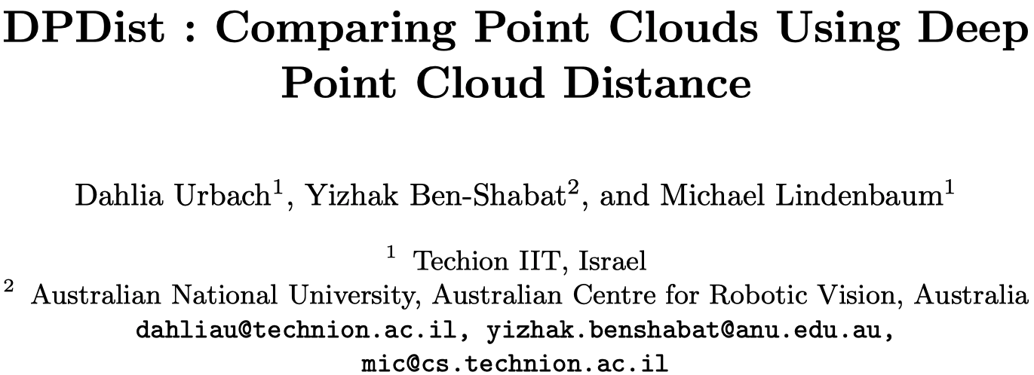

Slide 39
Challenges on comparing point clouds
unstructured, unordered, and may have a varying number of points
Non-grid structure：point clouds cannot be compared using a common metric

Slide 40
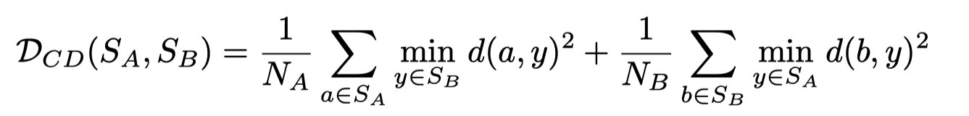
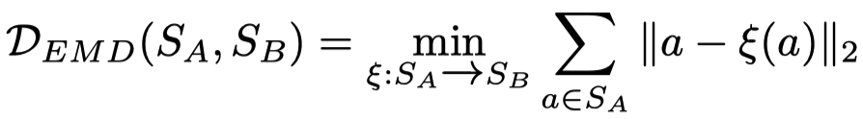
Current metrics for point cloud comparisons
Chamfer distance
Earth mover’s distance
Distance from set

Slide 41
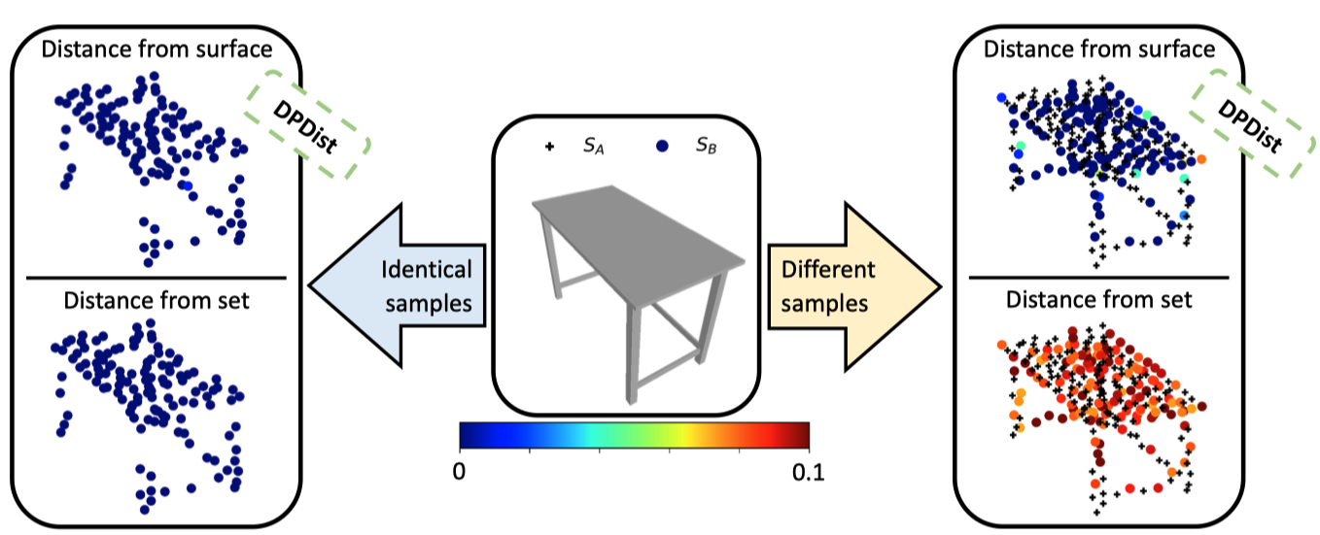
Distance from set vs Distance from surface

Slide 42
The core idea
when comparing point clouds sampled from a 3D surface, we usually want to compare their underlying surfaces and not the given sample points

Slide 43
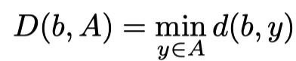
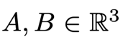
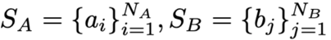
Point to surface distance
Continuous Surface:
Sampled Points:

Slide 44
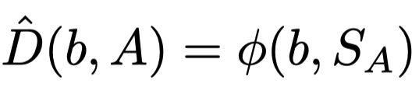
Point to surface distance - Approximation
Continuous Surface:
unknown
Sampled Points:

Slide 45
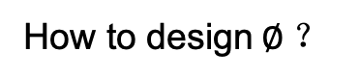
Point to surface distance - Approximation
How to design$∅ ？$
Continuous Surface:
unknown
Sampled Points:

Slide 46
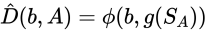
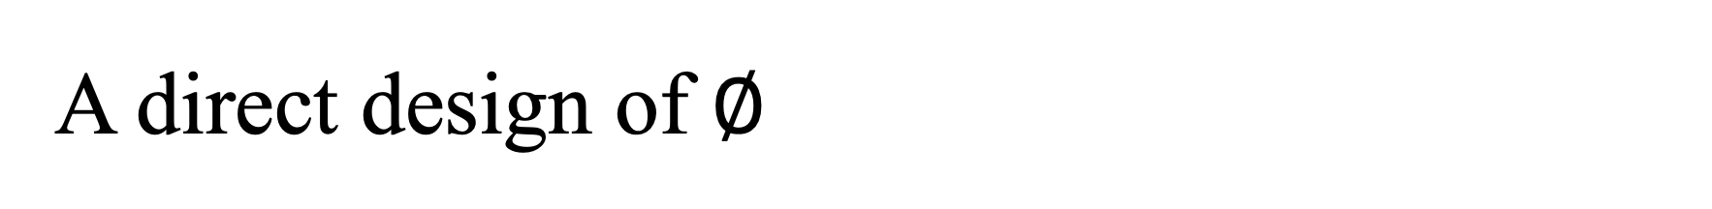
A direct design of $∅$
a network that accepts the coordinates of the point b, and some representation of the cloud of points S_{A} (e.g., PointNet or 3DmFV)
Hard to learn due to the large variation

Slide 47
Single point distance (SPD)
model the surface A by parts
every part is less geometrically complex

Slide 48


Grid Representation of Surface A
3DmFV
K×K×K grid points with F-D features
Pre-computed for every surface A

Slide 49


Overview of SPD
The local representation is a representation of the point cloud S_{A} , in a region determined by bj

Slide 50

DPDist - Distance Between Point Clouds

Slide 51

Experiments

Slide 52

Experiments

Slide 53

Experiments - generalization test

Slide 54

Visualization

Slide 55

Experiments - Registration Learning

Slide 56
Thanks

